Slide 1

SNIPE TEAM
4 January 2018
www.snipe.co.in
1
Notes:
1

Slide 2



Slide 3
Agenda
Contents
Introduction
Syntax of JavaScript
Events
Strings
Date
Objects
Array
Form Validation
DOM

Slide 4
Introduction
What is JavaScript?
JavaScript is a dynamic computer programming language. It is lightweight and most commonly used as a part of web pages, whose implementations allow client-side script to interact with the user and make dynamic pages. It is an interpreted programming language with object-oriented capabilities.
JavaScript was first known as LiveScript, but Netscape changed its name to JavaScrip.
The ECMA-262 Specification defined a standard version of the core JavaScript language.
* JavaScript is a lightweight, interpreted programming language.
* Designed for creating network-centric applications.
* Complementary to and integrated with Java AND Html.
* Open and cross-platform.

Slide 5
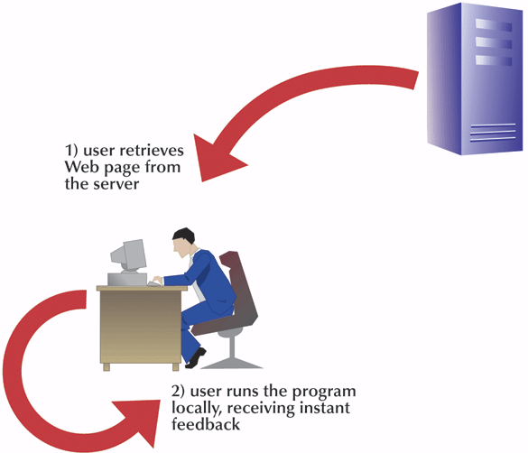
(contd..)
Client Side Scripting
Client-side programming
Runs programs on user’s computer
Programs likely to be more responsive to users
complement server-side programming

Slide 6
Why use client side programming?
(contd..)
client-side scripting (JavaScript) benefits:
usability: can modify a page without having to post back to the server (faster UI)
efficiency: can make small, quick changes to page without waiting for server
event-driven: can respond to user actions like clicks and key presses

Slide 7
Advantages of JavaScript
(contd..)
The merits of using JavaScript are:
* Less server interaction: You can validate user input before sending the page off to the server. This saves server traffic, which means less load on your server.
* Immediate feedback to the visitors: They don't have to wait for a page reload to see if they have forgotten to enter something.
* Increased interactivity: You can create interfaces that react when the user hovers over them with a mouse or activates them via the keyboard.
* Richer interfaces: You can use JavaScript to include such items as dragand-drop components and sliders to give a Rich Interface to your site visitors.

Slide 8
(contd..)
Limitations of JavaScript
We cannot treat JavaScript as a full-fledged programming language. It lacks the following important features:
* Client-side JavaScript does not allow the reading or writing of files. This has been kept for security reason.
* JavaScript cannot be used for networking applications because there is no such support available.
* JavaScript doesn't have any multithreading or multiprocessor capabilities.
Once again, JavaScript is a lightweight, interpreted programming language that allows you to build interactivity into otherwise static HTML pages.

Slide 9
Syntax of JavaScript
Syntax of Js
JavaScript can be implemented using JavaScript statements that are placed within the <script>... </script> HTML tags in a web page.
You can place the <script> tags, containing your JavaScript, anywhere within you web page, but it is normally recommended that you should keep it within the <head> tags.
The <script> tag alerts the browser program to start interpreting all the text between these tags as a script. A simple syntax of your JavaScript will appear as follows
<script……>
JavaScript Code
</script>
Script tag takes to important attributes
* Language
* Type

Slide 10
JavaScript Output
JavaScript Output
Writing into an HTML element, using innerHTML.
Writing into the HTML output using document.write().
Writing into an alert box, using window.alert().
Writing into the browser console, using console.log().

Slide 11
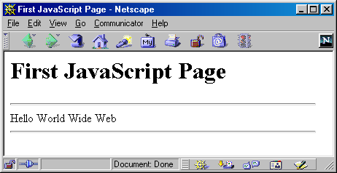
Where to put JavaScript
Javascript example is easy to code. JavaScript provides 3 places to put the JavaScript code:
Between the body tag of html
Between the head tag of html
In .js file (external javaScript)
<html>
<head><title>First JavaScript Page</title></head>
<body>
<h1>First JavaScript Page</h1>
<script type="text/javascript"> document.write("<hr>"); document.write("Hello World Wide Web"); document.write("<hr>");
</script>
</body>
</html>

Slide 12
Internal JS
The script tag specifies that we are using JavaScript.
The text/javascript is the content type that provides information to the browser about the data.
The document.write() function is used to display dynamic content through JavaScript.

Slide 13
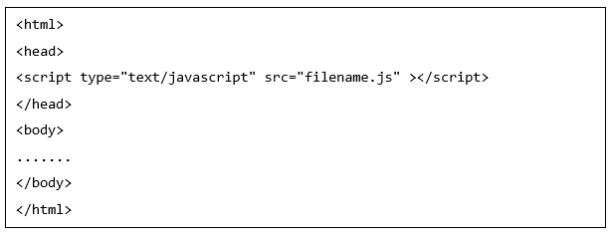
JavaScript in External File
External JS
You are not restricted to be maintaining identical code in multiple HTML files. The script tag provides a mechanism to allow you to store JavaScript in an external file and then include it into your HTML files.
Here is an example to show how you can include an external JavaScript file in your HTML code using script tag and its src attribute.

Slide 14
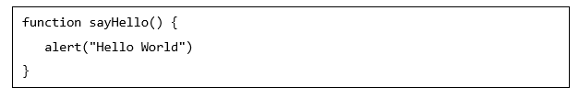
(contd..)
To use JavaScript from an external file source, you need to write all your JavaScript source code in a simple text file with the extension ".js" and then include that file as shown above.
For example, you can keep the following content in filename.js file and then you can use sayHello function in your HTML file after including the filename.js file.
Filename.js

Slide 15
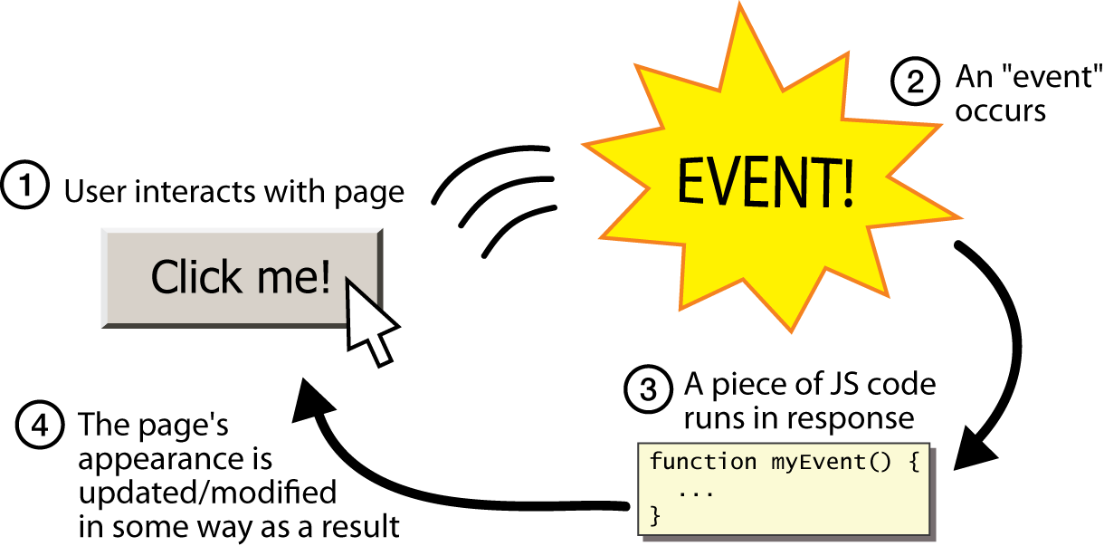
What is Event?
Events
JavaScript's interaction with HTML is handled through events that occur
when the user or the browser manipulates a page.

Slide 16
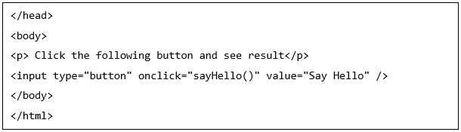
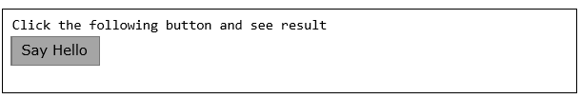
onclick Event Type :
This is the most frequently used event type which occurs when a user clicks the left button of his mouse. You can put your validation, warning etc., against this event type.
output

Slide 17
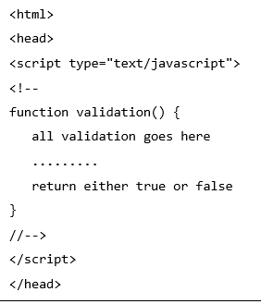
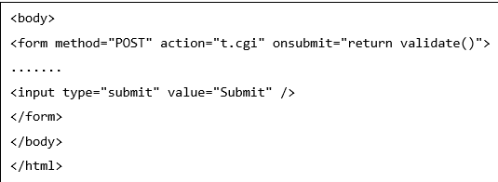
onsubmit Event Type
(contd..)
onsubmit is an event that occurs when you try to submit a form. You can put your form validation against this event type.
Example The following example shows how to use onsubmit. Here we are calling a validate() function before submitting a form data to the webserver. If validate() function returns true, the form will be submitted, otherwise it will not submit the data.

Slide 18
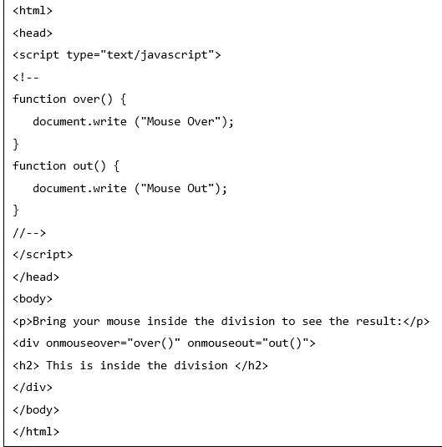

onmouseover and onmouseout
(contd..)
The onmouseover event triggers when you bring your mouse over any element and the onmouseout triggers when you move your mouse out from that element. For example
output

Slide 19
Alert Dialog Box
Dialog Box
An alert dialog box is mostly used to give a warning message to the users. We can use an alert box to give a warning message. Alert box gives only one button "OK" to select and proceed.
Confirmation Dialog Box
A confirmation dialog box is mostly used to take user's consent on any option. It displays a dialog box with two buttons: OK and Cancel. If the user clicks on the OK button, the window method confirm() will return true. If the user clicks on the Cancel button, then confirm() returns false

Slide 20
(contd..)
Prompt Dialog Box
The prompt dialog box is very useful when you want to pop-up a text box to get user input. Thus, it enables you to interact with the user. The user needs to fill in the field and then click OK.
This dialog box is displayed using a method called prompt() which takes two parameters:
(i) a label which you want to display in the text box and
(ii) a default string to display in the text box.
This dialog box has two buttons: OK and Cancel.
* If the user clicks the OK button, the window method prompt() will return the entered value from the text box.
* If the user clicks the Cancel button, the window method prompt() returns null.

Slide 21
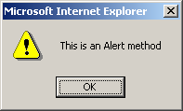
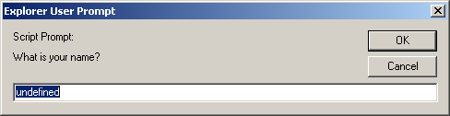
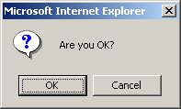
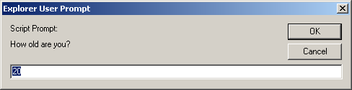
alert(),confirm(),prompt()
<script type="text/javascript"> alert("This is an Alert method"); confirm("Are you OK?"); prompt("What is your name?"); prompt("How old are you?","20");
</script>

Slide 22
Strings
Strings
A String is any text in quotes. U can use either single or double quotes.
JavaScript String
The JavaScript string is an object that represents a sequence of characters.
There are 2 ways to create string in JavaScript
By string literal
By string object (using new keyword)

Slide 23
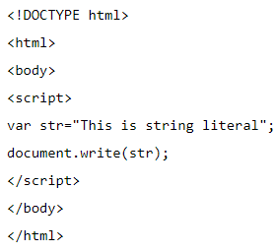
Creating Strings
By string literal
The string literal is created using double quotes. The syntax of creating string using string literal is given below:
var stringname="string value";
This is string literal

Slide 24
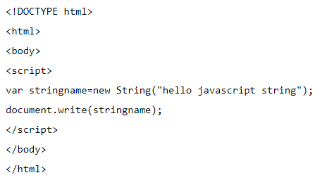
Creating Strings
By string object (using new keyword)
The syntax of creating string object using new keyword is given below:
var stringname=new String("string literal");
Here, new keyword is used to create instance of string.
Hello javascript string

Slide 25


Strings concatenate
Concatenating strings: There are 2 options to concatenate strings in javascript. We could either use + operator or concat() method.
Example: Concatenating strings using + operator.
Example: Concatenating string using concat() method
hellojavascript
hellojavascript

Slide 26
Strings Methods
String object has the following methods:
Length()
charAt()
indexOf()
lastIndexOff()
subString()
Split()
toUpperCase()
toLowerCase()

Slide 27

Strings Length
String Length
The length property returns the length of a string.This will count the total number of characters in the string and returns the value.
Example of code:
charAt()
charAt() is a method that returns the character from the specified index. Characters in a string are indexed from left to right. The index of the first character is 0, and the index of the last character in a string, called stringName, is stringName.length – 1.
Result:26

Slide 28

Finding string in string
Syntax
Use the following syntax to find the character at a particular index.
string.charAt(index)
* index: An integer between 0 and 1 less than the length of the string.
* Return Value Returns the character from the specified index.
Example code:
a

Slide 29

(contd..)
IndexOf()
This method returns the index within the calling String object of the first occurrence of the specified value, starting the search at from Index or -1 if the value is not found.
Use the following syntax to use the indexOf() method.
string.indexOf(searchValue)
searchValue: A string representing the value to search for.
fromIndex: The location within the calling string to start the search
from.
7

Slide 30

(contd..)
lastIndexOf()
This method returns the index within the calling String object of the last occurrence of the specified value, starting the search at fromIndex or -1 if the value is not found.
Syntax:
string.lastIndexOf(searchValue[, fromIndex])
Example code:
21
Both the indexOf(), and the lastIndexOf() methods return -1 if the text is not found.

Slide 31
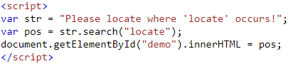
Searching for string in string
Search()
This method executes the search for a match between a regular expression and this String object.
Syntax:
string.search(regexp);
regexp : A regular expression object. If a non-RegExp object obj is passed, it is implicitly converted to a RegExp by using new RegExp(obj).
7

Slide 32

Extracting string parts
Slice()
slice() extracts a part of a string and returns the extracted part in a new string.The method takes 2 parameters: the starting index (position), and the ending index (position).
Result:
Banana

Slide 33
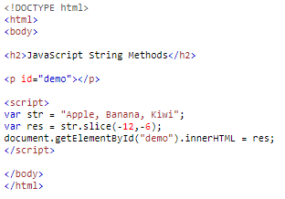
Slice() with negative parameter
If a parameter is negative, the position is counted from the end of the string.
Banana

Slide 34
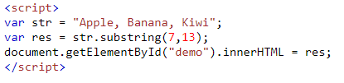
(contd..)
subString()
This method returns a subset of a String object.
Syntax:
string.substring(indexA, [indexB])
indexA : An integer between 0 and one less than the length of the string.
indexB : (optional) An integer between 0 and the length of the string.
Result:
Banana

Slide 35
(contd..)
toLowerCase()
This method returns the calling string value converted to lowercase.
Syntax:
string.toLowerCase( )
toUpperCase()
This method returns the calling string value converted to uppercase.
Syntax:
string.toUpperCase()

Slide 36
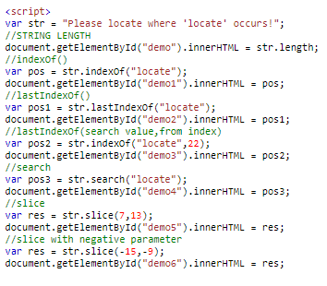
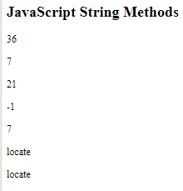
Example on String methods
(contd..)

Slide 37
JavaScript Date
Date
The Date object is a datatype built into the JavaScript language. Date objects are created with the new Date() .
Once a Date object is created, a number of methods allow you to operate on it. Most methods simply allow you to get and set the year, month, day, hour, minute, second, and millisecond fields of the object, using either local time or UTC (universal, or GMT) time.
Syntax:
new Date( )
new Date(milliseconds)
new Date(datestring)
neDate(year,month,date[,hour,minute,second,millisecond ])

Slide 38
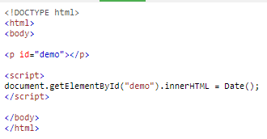

(contd..)
No Argument: With no arguments, the Date() constructor creates a Date object set to the current date and time.
milliseconds: When one numeric argument is passed, it is taken as the internal numeric representation of the date in milliseconds, as returned by the getTime() method.
Example for date()
Result

Slide 39
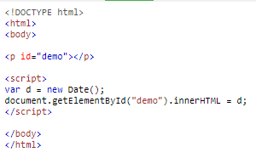
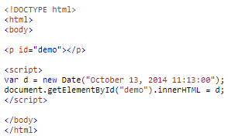
Example for new date()
(contd..)
Result
Example for new Date(datestring)
Result

Slide 40
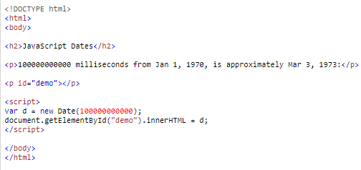

(contd..)
Example for new Date(milliseconds)
It counts 100000000000 milliseconds from Jan 1, 1970

Slide 41
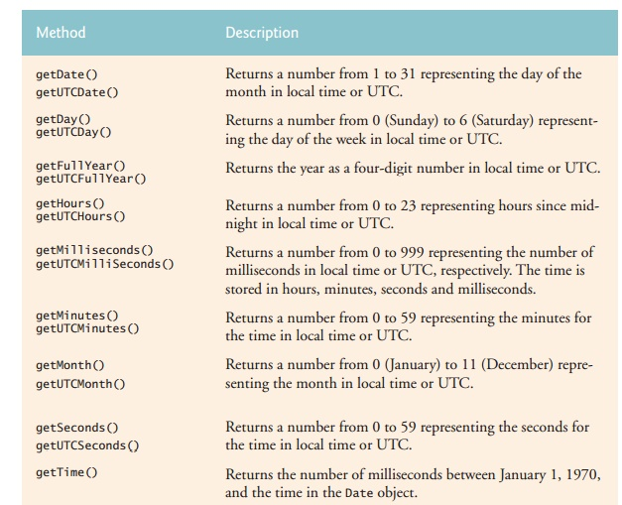
Date Methods
Date Methods
When a Date object is created, a number of methods allow you to operate on it. Date methods allow you to get and set the year, month, day, hour, minute, second, and millisecond of objects, using either local time or UTC (universal, or GMT) time.
Get Date Methods

Slide 42
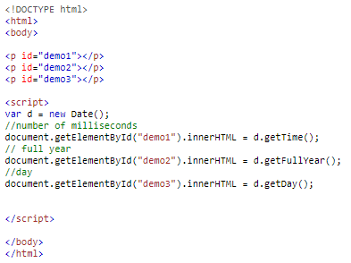

Date Methods
Get date method example
Result

Slide 43
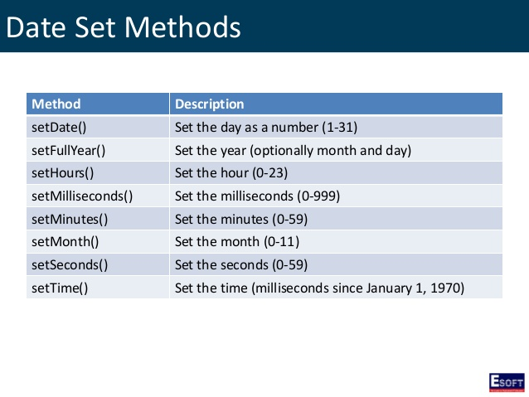
Date set methods:
Date Methods

Slide 44
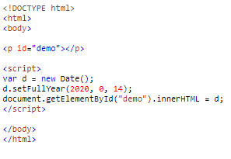
Example for date set method:
Date Methods
Result

Slide 45
JavaScript Object:
Objects
A javaScript object is an entity having state and behavior (properties and method).
For example: car, pen, bike, chair, glass, keyboard, monitor etc.
JavaScript is template based not class based. Here, we don't create class to get the object. But, we direct create objects.
JavaScript has object literals, written with this syntax:
{ name1 : value1 , ... , nameN : valueN }

Slide 46
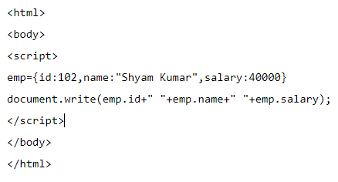
Three ways to create an object
Creating Object
You can use an object literal:
Syntax of creating object using object literal
object={property1:value1,
property2:value2.....
propertyN:valueN}
For example:
Output:

Slide 47
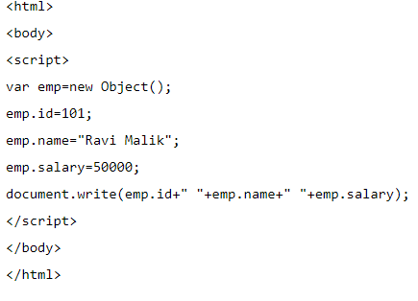
(contd..)
By creating instance of object:
The syntax of creating object directly is given below:
var objectname=new Object();
Output:

Slide 48
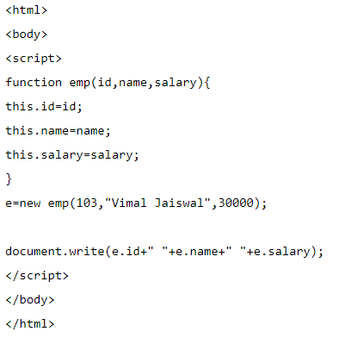

By using an Object constructor Here, we need to create function with arguments. Each argument value can be assigned in the current object by using this keyword. here this keyword refers to the current object.
(contd..)
Output:

Slide 49
Accessing properties of an object
Object Property
Starting with ECMAScript 5, there are three native ways to list/traverse object properties:
objectName.property
or
objectName[“property”]
or
objectName[expression]
for...in loops This method traverses all enumerable properties of an object and its prototype chain

Slide 50
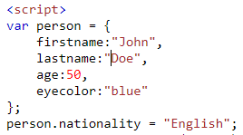
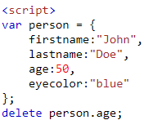
Adding new properties to object:
Adding and deleting Object property
Person object already exists, to that we add new property
Deleting Properties:
Deleting age property of person object

Slide 51
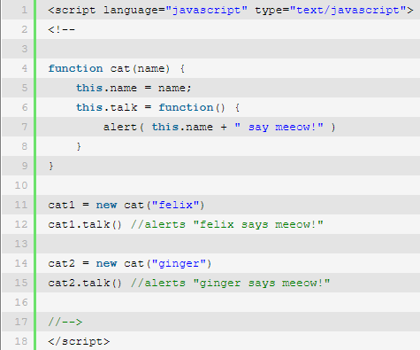
Object constructor:
Object Constructor
Object Constructor
Constructors are like regular javaScript functions, but we use them with the "new" keyword.

Slide 52
Array An array is a special variable, which can hold more than one value at a time. An array can hold many values under a single name, and you can access the values by referring to an index number. We can create array by 2 methods: * array literal * JavaScript array directly(new keyword)
JavaScript Array

Slide 53
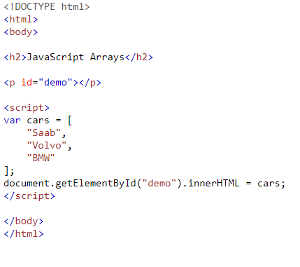

Creating Array
Array Literal
Using an array literal is the easiest way to create a JavaScript Array.
Syntax:
var array_name = [item1, item2, ...];
Result:

Slide 54
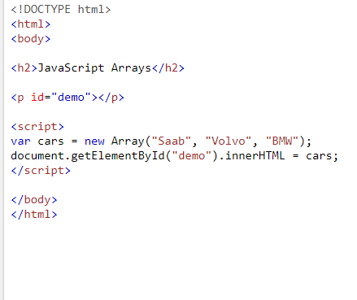

(contd..)
Using javaScript keyword new
Syntax of creating array directly:
var arrayName=new Array();
Result

Slide 55
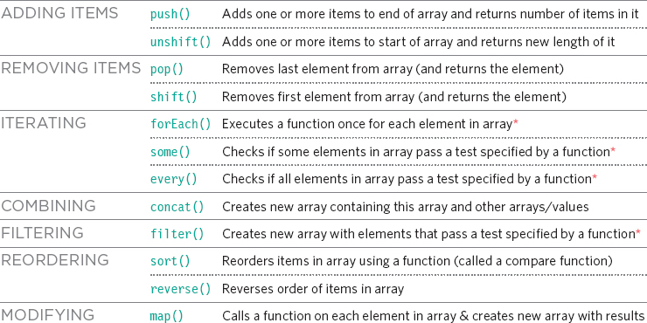
Array Methods

Slide 56
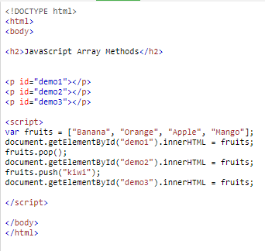
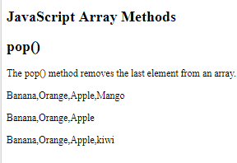
Array Push() And Pop() methods
Array Methods

Slide 57
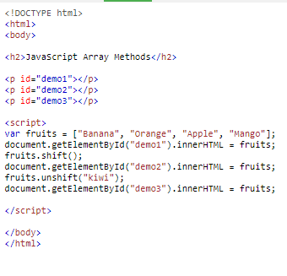
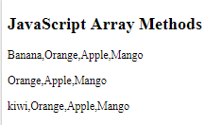
Array shift() and unshift() Methods
Array Methods

Slide 58
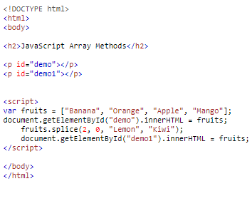
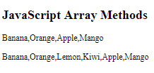
Splicing an Array
Array Methods
The splice() method can be used to add new items to an array:
The first parameter (2) defines the position where new elements should be added (spliced in).
The second parameter (0) defines how many elements should be removed.
The rest of the parameters ("Lemon" , "Kiwi") define the new elements to be added.

Slide 59
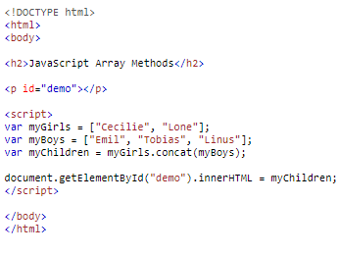

Merging (Concatenating) Arrays
Array Methods
The concat() method creates a new array by merging (concatenating) existing arrays:

Slide 60
Slicing an Array
Array Methods
The slice() method slices out a piece of an array into a new array.
This example slices out a part of an array starting from array element 1
The slice() method creates a new array. It does not remove any elements from the source array.

Slide 61
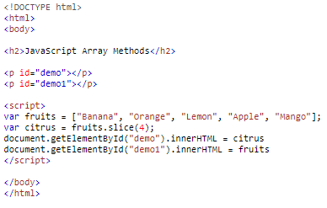
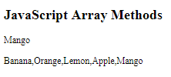
slice() method Example
Array Methods

Slide 62
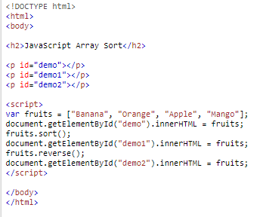
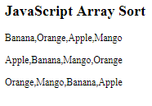
Array Sort()
Array sort
Sorting an Array .The sort() method sorts an array alphabetically.
Reversing an Array
The reverse() method reverses the elements in an array.

Slide 63
Numerical Sort
Numerical sort
By default, the sort() function sorts values as strings.
This works well for strings ("Apple" comes before "Banana").
However, if numbers are sorted as strings, "25" is bigger than "100", because "2" is bigger than "1".
Because of this, the sort() method will produce incorrect result when sorting numbers.
We can fix this by providing a compare function:

Slide 64
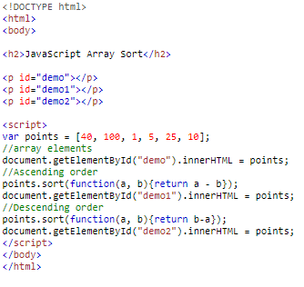

Example of Numerical sort
Example Array Numerical sort

Slide 65

Functions
Functions
A function is a block of reusable code. A function allows to write code once and use it as many times as we want just by calling the function.
JavaScript function syntax
Use the function keyword top define a function, followed by the name of the function. The name of the function should be followed by parentheses()
Function parameters are optional. The parameter names must be with in parentheses separated by comma.

Slide 66


Example: JavaScript function to add 2 numbers
Calling the JavaScript function: Call the JavaScript by specifying the name of the function and values for the parameters if any.
What happens when you do not specify values for the function parameters when calling the function
The parameters that are missing values are set to undefined.
What happens when you specify too many parameter values when calling the function
The extra parameter values are ignored

Slide 67


Different ways of defining functions
Defining JavaScript function using function declaration
Function Hoisting: By default, javascript moves all the function declaration to the top of the current scope. This is called function hoisting.

Slide 68
Form Validation
Form Validation
Form validation normally used to occur at the server, after the client had entered all the necessary data and then pressed the Submit button. If the data entered by a client was incorrect or was simply missing, the server would have to send all the data back to the client and request that the form be resubmitted with correct information. This was really a lengthy process which used to put a lot of burden on the server. JavaScript provides a way to validate form's data on the client's computer before sending it to the web server.

Slide 69
Functions of Form Validation
Form validation generally performs two functions.
Basic Validation - First of all, the form must be checked to make sure all the mandatory fields are filled in. It would require just a loop through each field in the form and check for data.
Data Format Validation - Secondly, the data that is entered must be checked for correct form and value. Your code must include appropriate logic to test correctness of data.
HTML form validation can be done by JavaScript. If a form field (fname) is empty, this function alerts a message, and returns false, to prevent the form from being submitted:
function validateForm() { var x = document.forms["myForm"]["fname"].value; if (x == "") { alert("Name must be filled out"); return false; } }

Slide 70


Example of Form Validation
Result

Slide 71
DOM
DOM(Document Object Model)
The DOM defines a standard for accessing documents:
"The W3C Document Object Model (DOM) is a platform and language-neutral interface that allows programs and scripts to dynamically access and update the content, structure, and style of a document."
The W3C DOM standard is separated into 3 different parts:
Core DOM - standard model for all document types
XML DOM - standard model for XML documents
HTML DOM - standard model for HTML documents

Slide 72
HTML DOM
What is the HTML DOM?
The HTML DOM is a standard object model and programming interface for HTML. It defines:
The HTML elements as objects
The properties of all HTML elements
The methods to access all HTML elements
The events for all HTML elements
In other words: The HTML DOM is a standard for how to get, change, add, or delete HTML elements.

Slide 73
DOM Methods
DOM Methods:
HTML DOM methods are actions you can perform (on HTML Elements).
HTML DOM properties are values (of HTML Elements) that you can set or change.
getElementById Method
The most common way to access an HTML element is to use the id of the element.
The innerHTML Property
The easiest way to get the content of an element is by using the innerHTML property.
The innerHTML property is useful for getting or replacing the content of HTML elements.

Slide 74

DOM Representation

Slide 75
FAQ
What is JavaScript?
What is the difference between JavaScript and jscript?
How to use external JavaScript file?
What is BOM?
What is DOM? What is the use of document object?
What is the use of window object?
What is the use of history object?
How to create function in JavaScript?
How to write html code dynamically using JavaScript?
How to create objects in JavaScript?
How to create array in JavaScript?
Difference between Client side JavaScript and Server side JavaScript?
In which location cookies are stored on the hard disk?

Slide 76
FAQ
14. What is NaN? What is its type? How can you reliably test if a value is equal to NaN?
15. Discuss possible ways to write a function isInteger(x) that determines if x is an integer.
16. Write a simple function (less than 160 characters) that returns a boolean indicating whether or not a string is a palindrome.
17. Write a sum method which will work properly when invoked using either syntax below.
console.log(sum(2,3)); // Outputs 5
console.log(sum(2)(3)); // Outputs 5
18. What will the following code output to the console:
console.log((function f(n){return ((n > 1) ? n * f(n-1) : n)})(10)); Explain your answer.
What is this?
What is difference between View state and Session state?

Slide 77
FAQ
21. What are the pop up boxes available in JavaScript?
22. How can we detect OS of the client machine using JavaScript?
23. How to submit a form using JavaScript by clicking a link?
24. Is JavaScript faster than ASP script?
25. How to validate email in JavaScript?

Slide 78


